Slide 1
Navigating the Cyber Frontier: Cyber Threat Intelligence and advanced 5G/6G Technology
Huzur Saran
Centre of Excellence in Cybersecurity &
Bharti School of Telecom Technology
Indian Institute of Technology, Delhi

Slide 2
Summary
5G & eventually 6G technology brings unprecedented opportunities and challenges.
We explore the dynamic synergies between Cyber Threat Intelligence (CTI) and 5G/6G and vulnerabilities that arise.
Integration of Cyber Threat Intelligence in the 6G paradigm. The role of proactive and predictive intelligence to fortify networks against wide array of cyber threats, from sophisticated attacks on network infrastructure to emerging risks inherent in the Internet of Things (IoT).
Evolving role of AI and machine learning in enhancing threat detection and response mechanisms, as well as the collaborative efforts required across industries and research communities to fortify the cyber resilience of 6G networks.

Slide 3
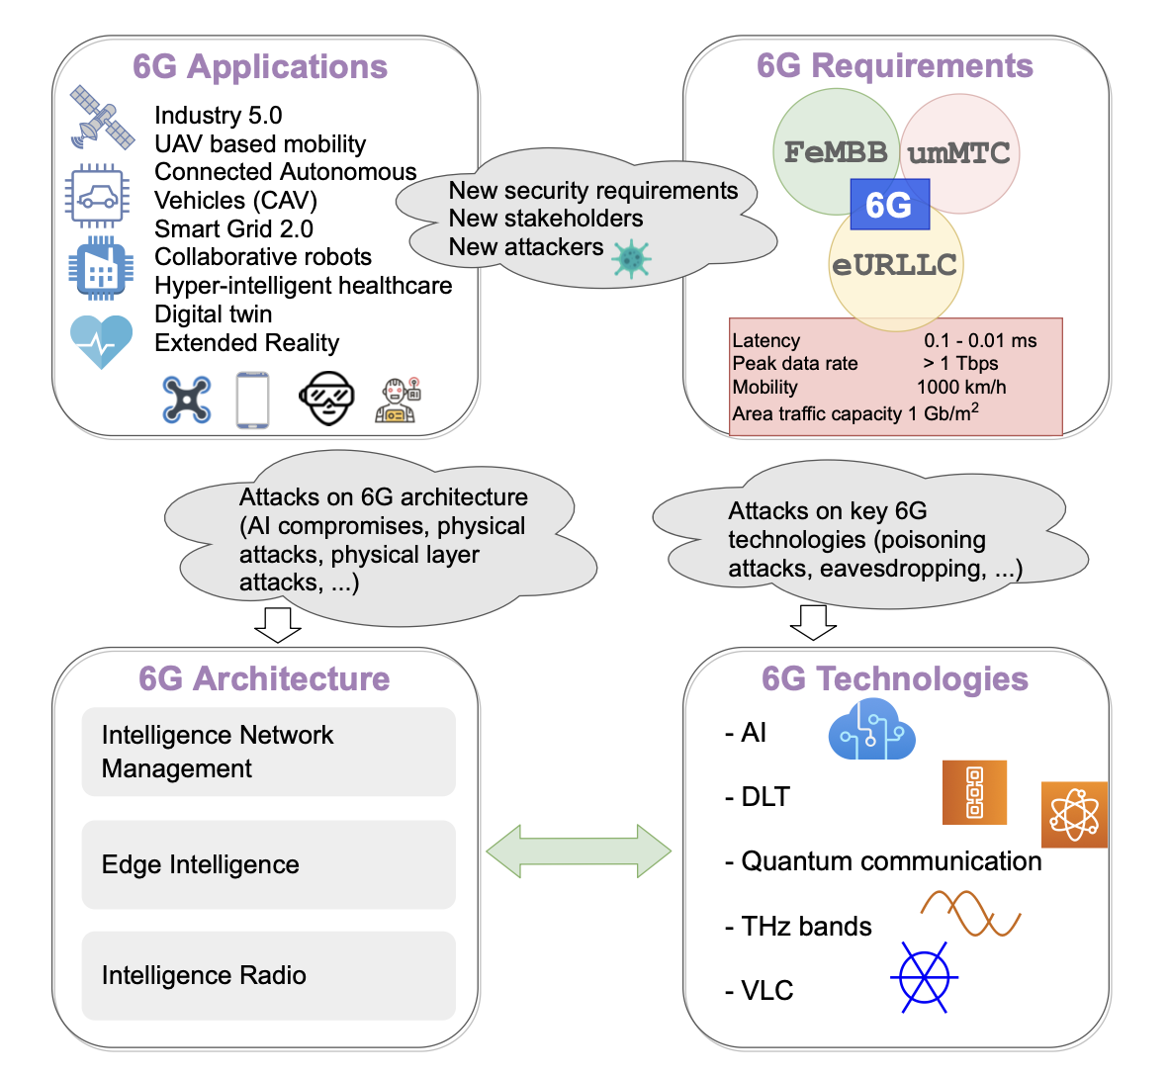
6G Key features
Advanced Applications
Intelligent Architecture
Distributed Sensing &
Artificial Intelligence
Stringent Requirements
Enabling technologies
Quantum/VLC/THz

Slide 4
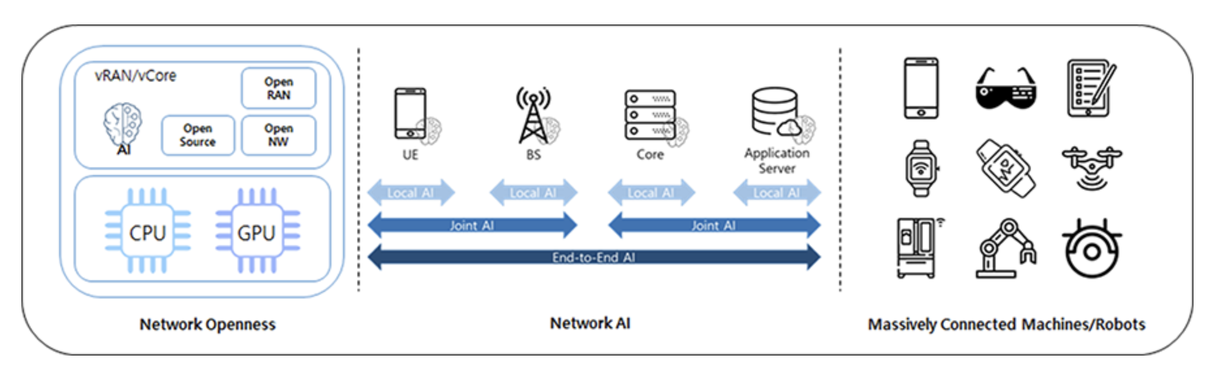
6G Key features
Trustworthiness is expected to be an essential requirement of 6G
Network openness, SW-based mobile communication system, virtualization, network AI, and quantum computing, directly affect security and privacy

Slide 5
Expanded Threat Landscape
Threats from Network AI: By using the characteristics of training and interference of AI, attacker can intentionally fool AI model by entering deceptive data to make network system unstable, malfunctioning or unavailable, which is called Adversarial Machine Learning.
Privacy Threats: mobile network operators (MNOs) and external service providers are expected to analyze user information in various ways through data analytics and AI technologies to enhance quality-of-service (QoS) and quality-of-experience (QoE). However, personalization technologies in 6G open door for fine-grained privacy invasion. Thus, without reliable and secure environment, the use of user information may leak user information and cause serious threats to user privacy. [4]
Threats from Virtualization/Containerization: By employing virtualization/containerization, operators have great advantages in terms of capital expenditure (CAPEX) and operating expenditure (OPEX). However, unless hypervisor, which manages VMs, or OS is securely managed, vulnerabilities can be easily spread over within all VMs or containers.
Threats from Introduction of Quantum Computing: Quantum computing (QC) can rapidly solve computationally very heavy problems such as the prime factorization of a very large number and the problem of discrete logarithms by utilizing quantum mechanical properties such as superposition and entanglement. Since QC is expected to be widely available in the 6G era, some of crypto algorithms will not be secure anymore.

Slide 6
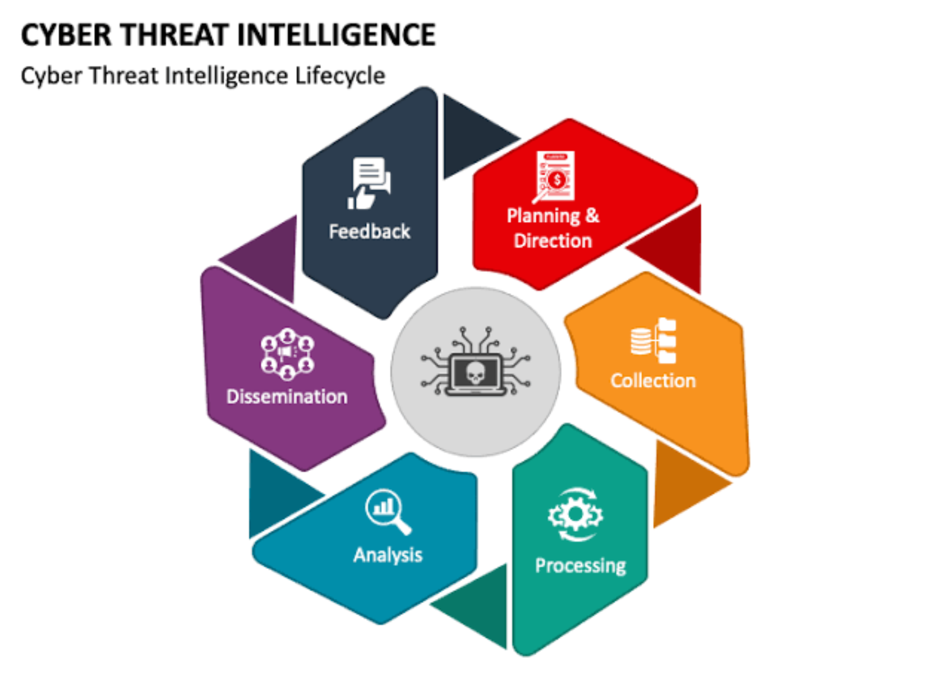
Understand threat trends and anticipate specific cyber attacks with thorough knowledge of threat landscape.
Threat Intelligence provides precise, tailored and reliable information for data-driven strategic decisions.

Slide 7
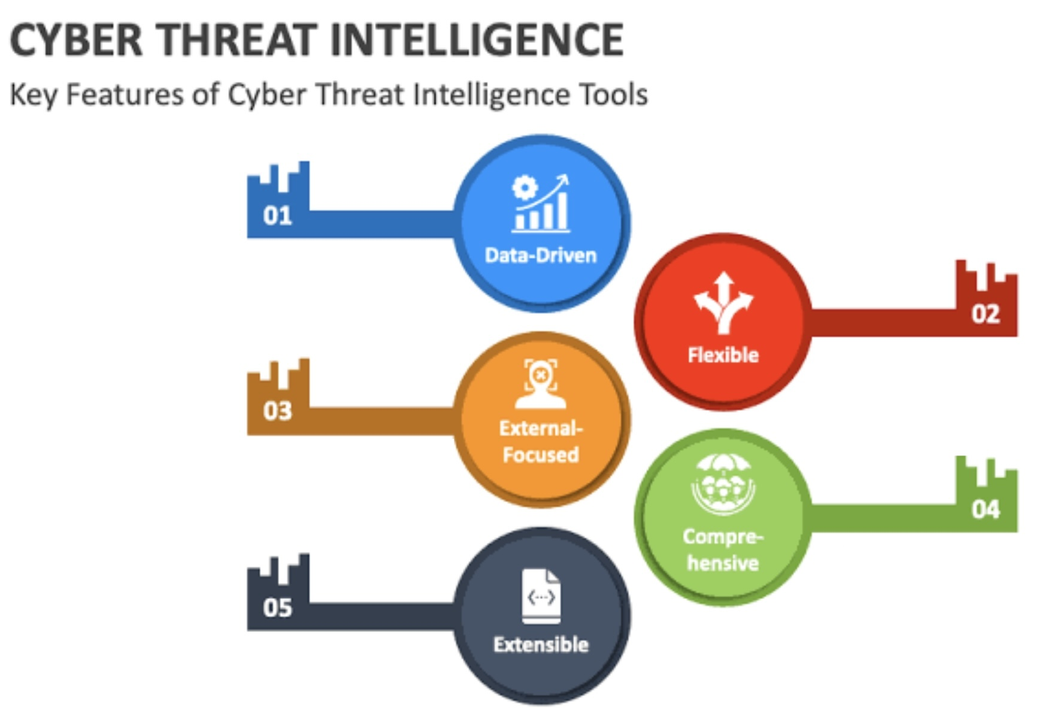

Slide 8
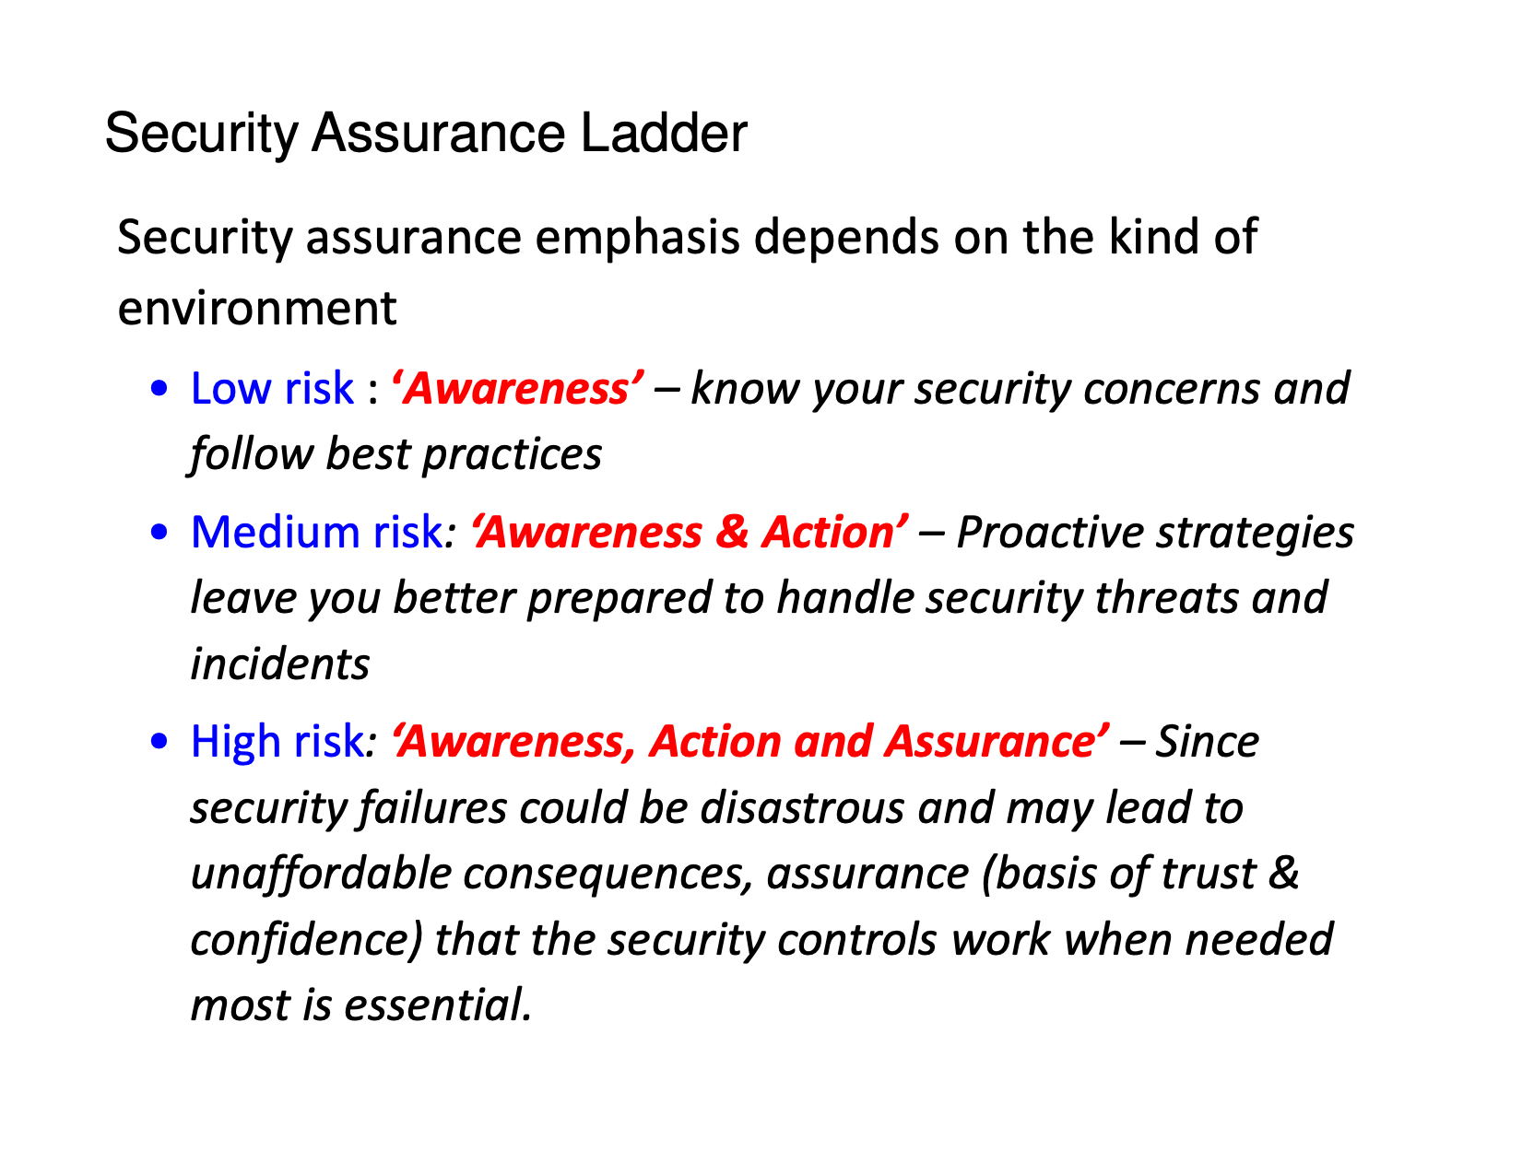

Slide 9
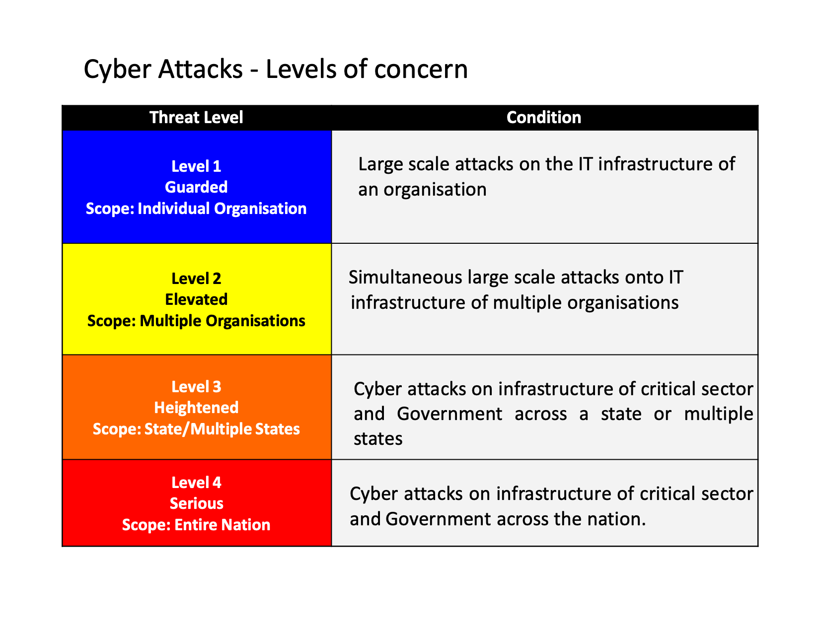

Slide 10
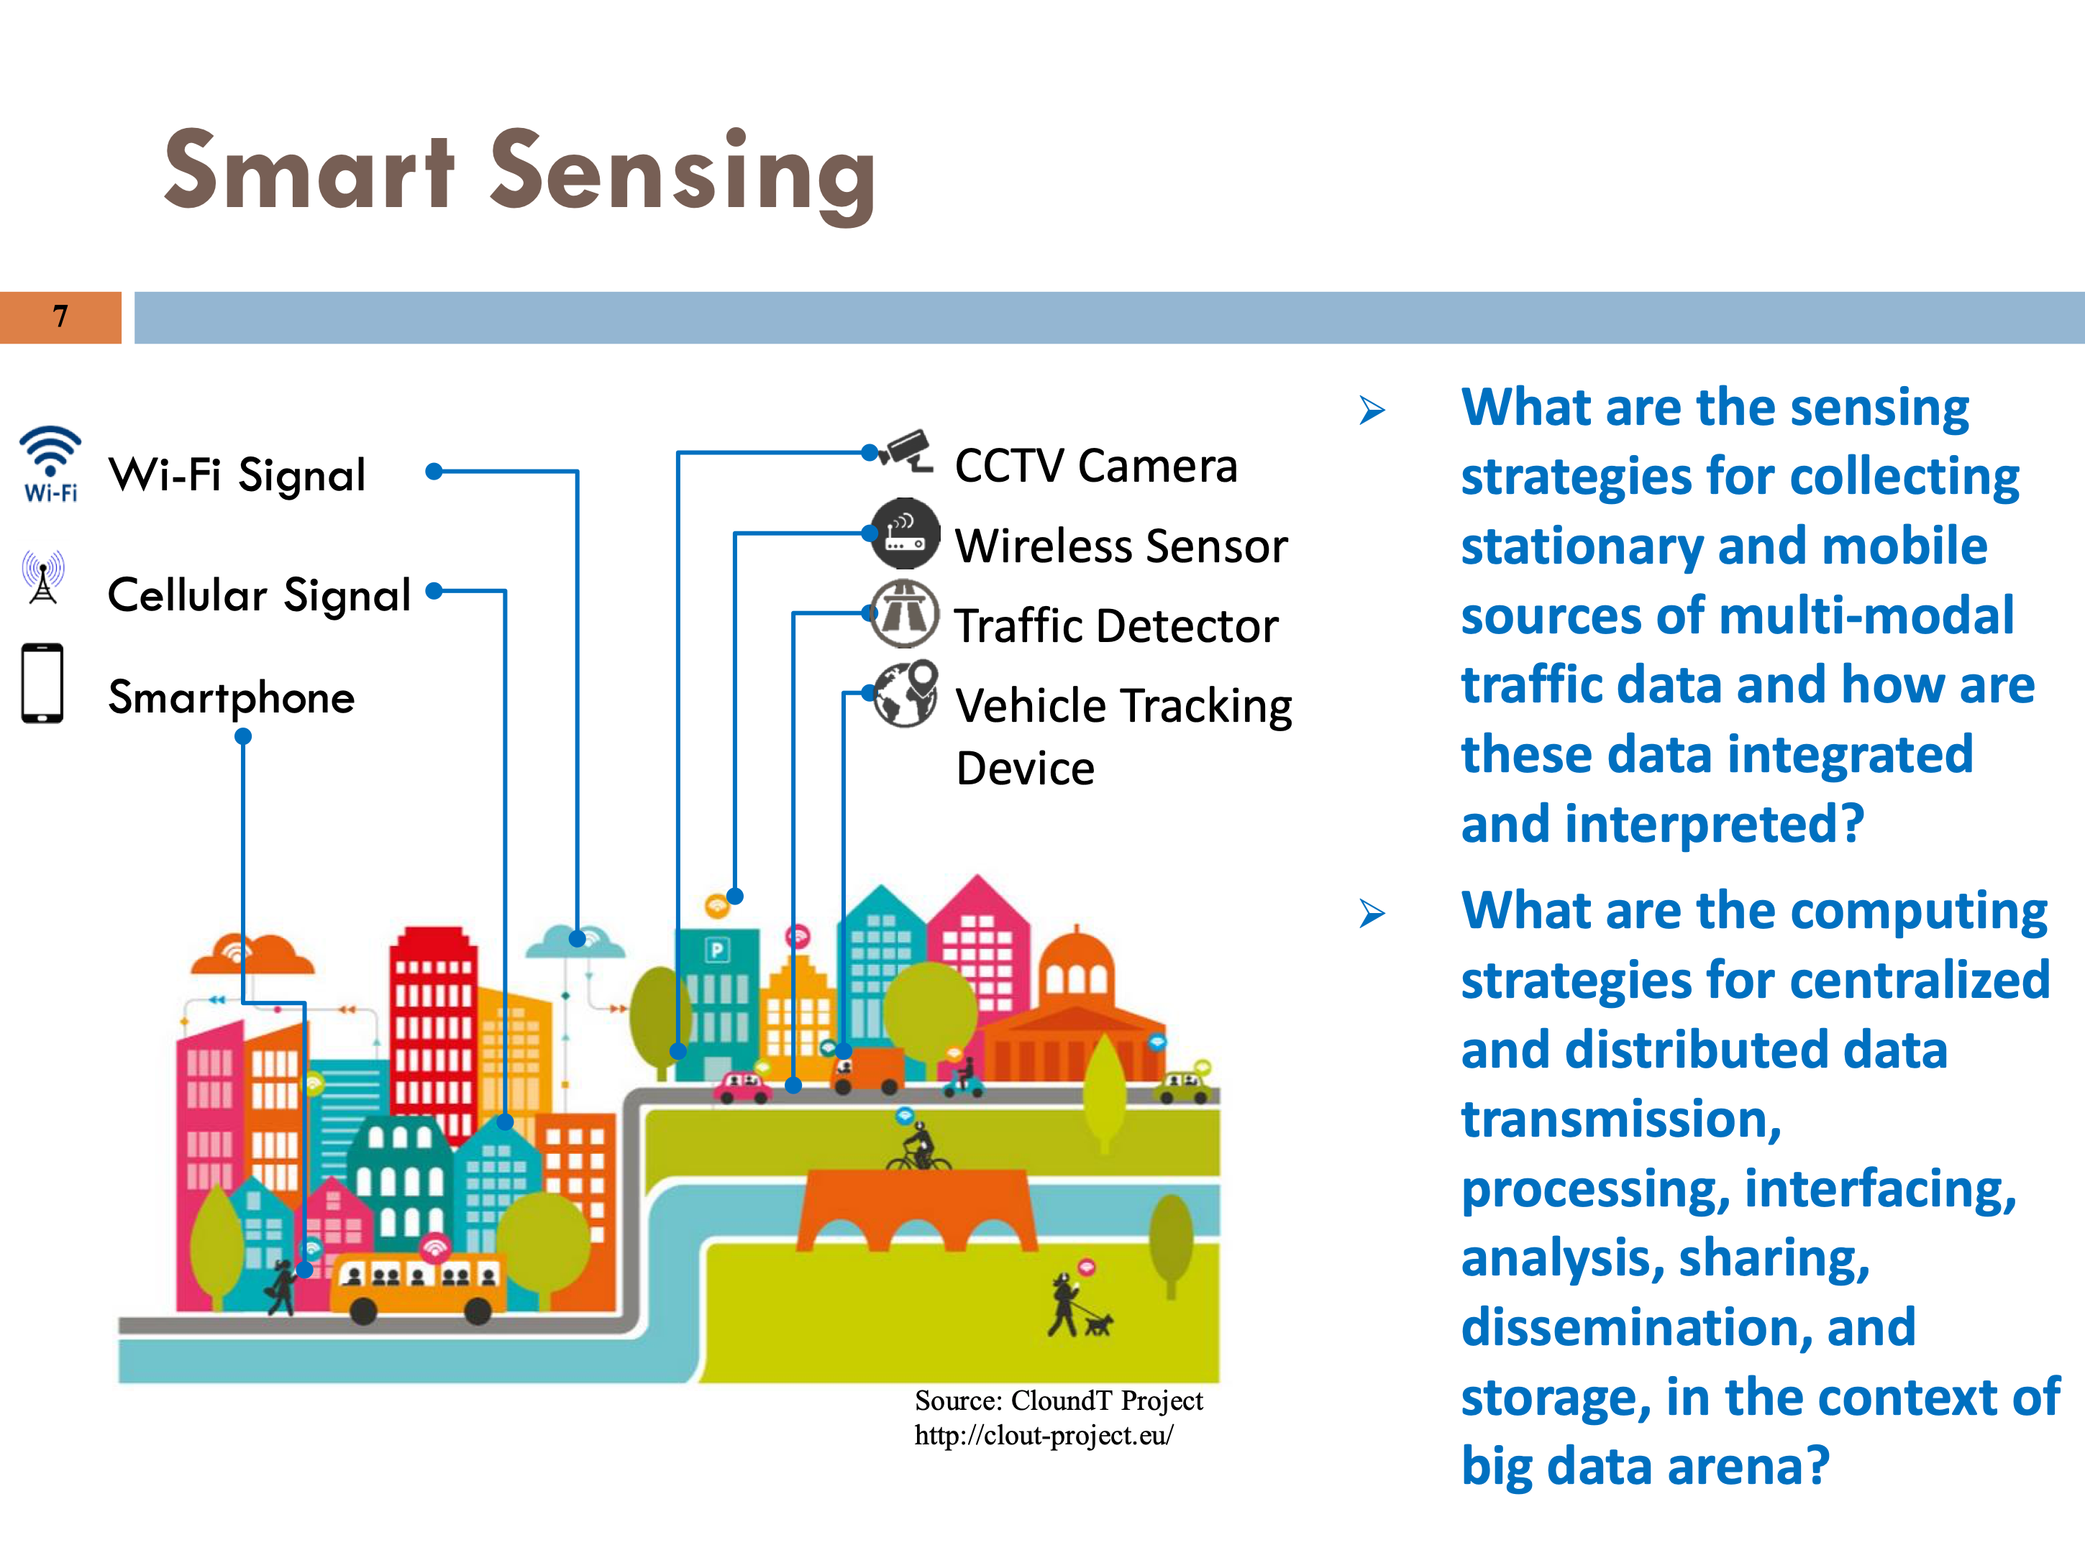


Slide 11
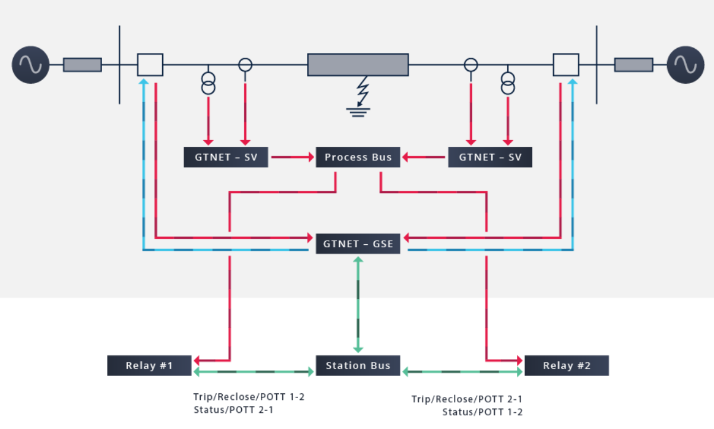

CRITICIAL INFRASTRUCTURE PROTECTION – GRID ATTACK SURFACE IN SUBSTATIONS WITH IEC 61850

Slide 12
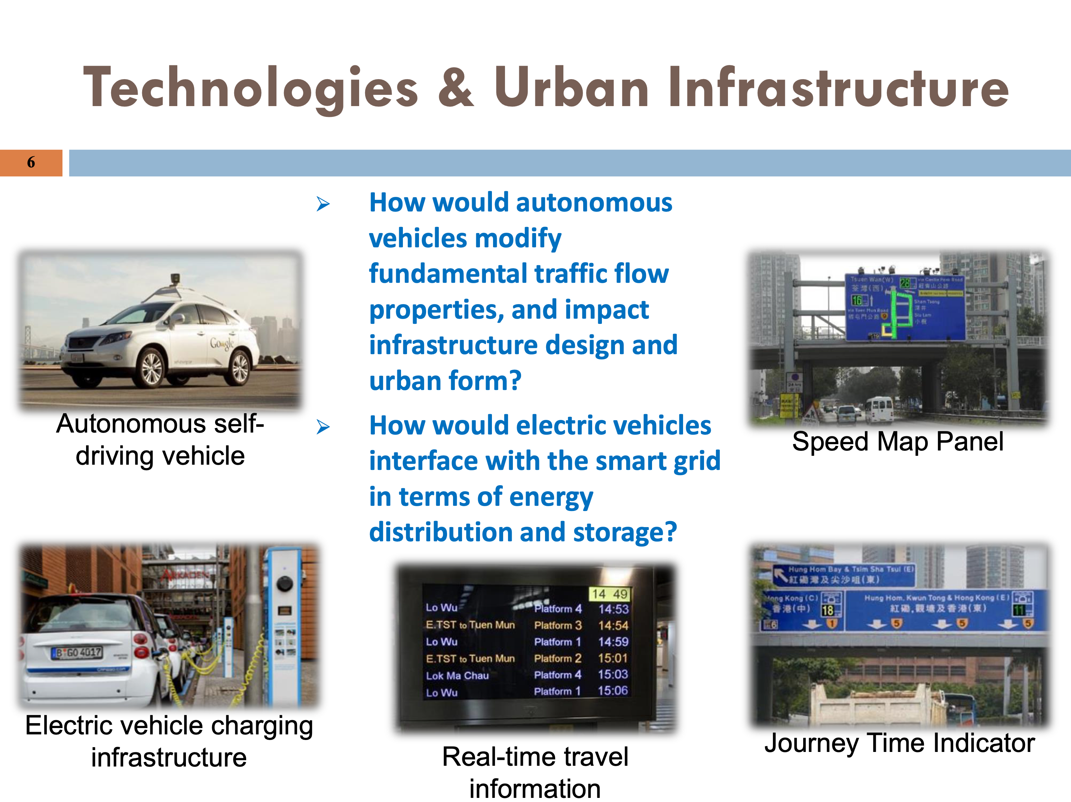

Slide 13
Human Factors
Often complexity of technology and its Human interface is a challenge
Social Engineering attacks
Ease of large scale payments may lead to much larger losses/impact
For the average criminal, the psychological manipulation of vulnerable users is far easier then the technological challenge of software penetration.

Slide 14
Crisis Management Drill
Developed a comprehensive crisis management plan for countering cyber attacks and cyber terrorism. This Plan has been approved by the National Crisis Management Committee and is being implemented across key Central Govt. Ministries/Departments and all States/UTs. This plan is intended
To ensure that interruption or manipulations of critical functions/services in critical sector organisations are brief, infrequent and manageable and cause least possible damage
To enable respective administrative Ministries/Departments to draw- up their own contingency plans
To assist organisations to put in place mechanisms to effectively deal with cyber security crisis and be able to pin point responsibilities and accountabilities right down to individual level

Slide 15
